Slide 1
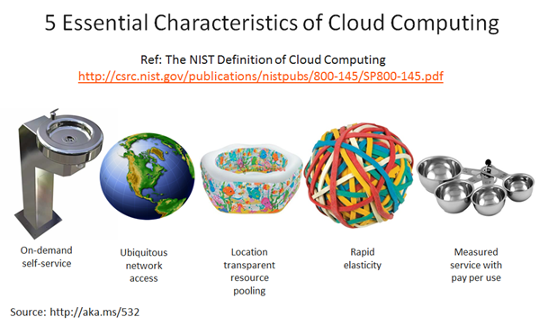
Characteristics/Features of Cloud Computing

Slide 2
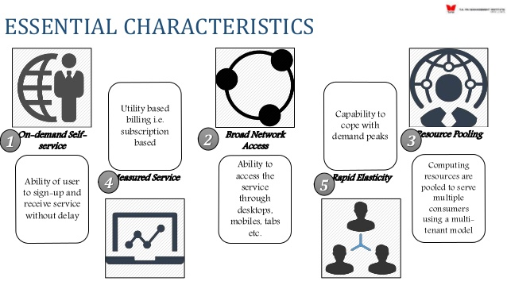
Characteristics
On Demand Self Service
Broad Network Access
Resource Pooling
Rapid Elasticity
Measured Service
Multi Tenacity

Slide 3
On Demand Self Service
Cloud Computing allows the users to use web services and resources on demand. One can logon to a website at any time and use them.
computer services such as email, applications, network or server service can be provided without requiring human interaction with each service provider.
Cloud service providers providing on demand self services include Amazon Web Services (AWS), Microsoft, Google, IBM and Salesforce.com.

Slide 4
Rapid Elasticity
It is very easy to scale the resources vertically or horizontally at any time. Scaling of resources means the ability of resources to deal with increasing or decreasing demand.
The resources being used by customers at any given point of time are automatically monitored.
Cloud services can be rapidly and elastically provisioned, in some cases automatically, to quickly scale out and rapidly released to quickly scale in.
To the consumer, the capabilities available for provisioning often appear to be unlimited and can be purchased in any quantity at any time.

Slide 5
Measured Service
Cloud computing resource usage can be measured, controlled, and reported providing transparency for both the provider and consumer of the utilised service.
Cloud computing services use a metering capability which enables to control and optimise resource use.
This implies that just like air time, electricity or municipality water IT services are charged per usage metrics – pay per use.
The more you utilise the higher the bill. Just as utility companies sell power to subscribers, and telephone companies sell voice and data services, IT services such as network security management, data center hosting or even departmental billing can now be easily delivered as a contractual service.

Slide 6
Broad Network Access
Cloud Capabilities are available over the network and accessed through standard mechanisms that promote use by heterogeneous thin or thick client platforms such as mobile phones, laptops and PDAs.
Since cloud computing is completely web based, it can be accessed from anywhere and at any time.

Slide 7
Resource Pooling
Cloud computing allows multiple tenants to share a pool of resources. One can share single physical instance of hardware, database and basic infrastructure.
The provider’s computing resources are pooled together to server multiple consumers using multiple-tenant model, with different physical and virtual resources dynamically assigned and reassigned according to consumer demand.
The resources include among others storage, processing, memory, network bandwidth, virtual machines and email services.

Slide 8
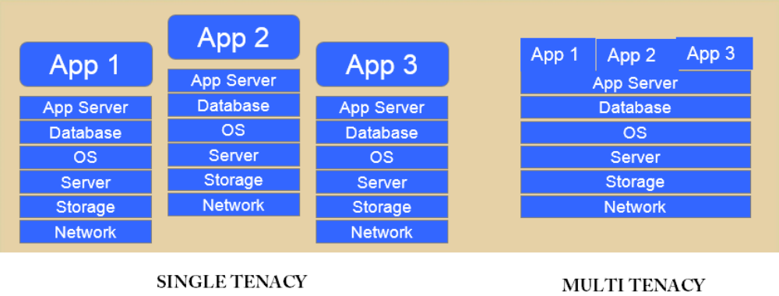
Multi Tenacity
is the 6th characteristics of cloud computing advocated by the Cloud Security Alliance.
It refers to the need for policy-driven enforcement, segmentation, isolation, governance, service levels, and chargeback/billing models for different consumer constituencies.
Consumers might utilize a public cloud provider’s service offerings or actually be from the same organization, such as different business units rather than distinct organizational entities, but would still share infrastructure.

Slide 9
